Slide 1
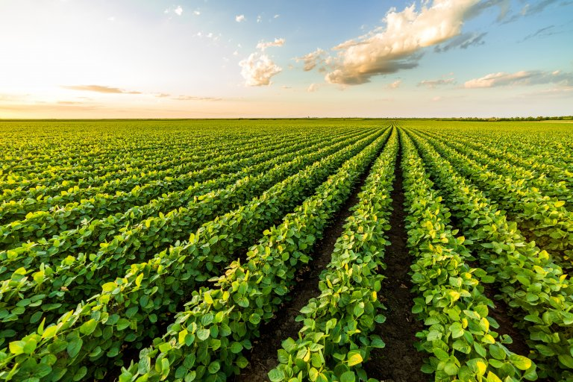


Crop production prediction
-Ashish
© All rights reserved by Fireblaze Technologies Pvt. Ltd.

Slide 2

Problem Statement
  Enhancement of agricultural productivity in diverse regions of India by investigating the impact of key factors—soil nutrients (N, P, K), pH, rainfall, and temperature—on crop yield. The goal is to formulate data-driven strategies for efficient resource utilization, crop selection, and improved farming practices, considering variations in soil and climatic conditions.
© All rights reserved by Fireblaze Technologies Pvt. Ltd.

Slide 3


About the Data
  Geographic regions (State_Name).
  Diverse crop types and varieties.
  Soil nutrient levels (N, P, K).
© All rights reserved by Fireblaze Technologies Pvt. Ltd.

Slide 4
About the Data
  Environmental conditions (pH, rainfall, temperature).
  Agricultural metrics (Area, Production, Yield).
  Insights for informed decisions on crop productivity.
© All rights reserved by Fireblaze Technologies Pvt. Ltd.

Slide 5
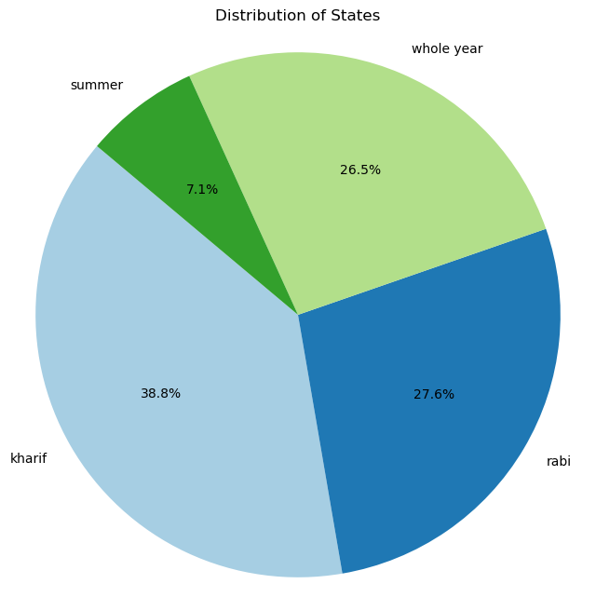
Descriptive Analysis
© All rights reserved by Fireblaze Technologies Pvt. Ltd.

Slide 6
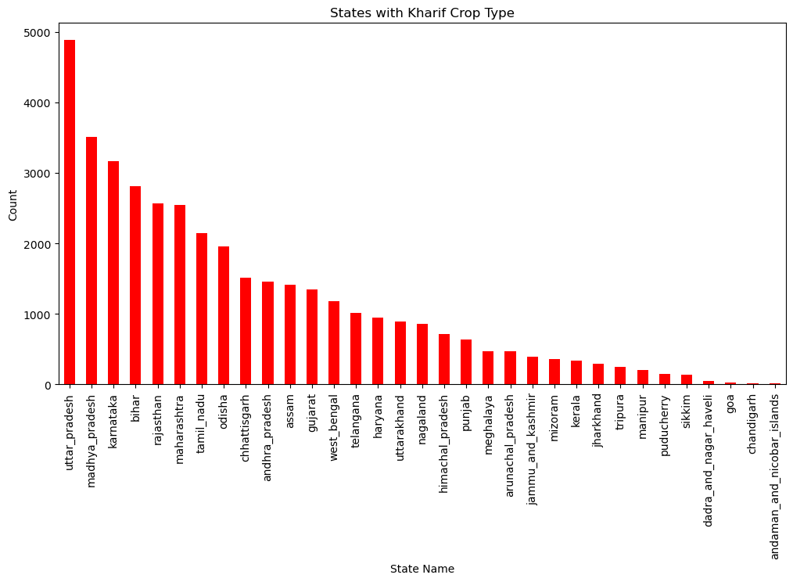
Descriptive Analysis
© All rights reserved by Fireblaze Technologies Pvt. Ltd.

Slide 7
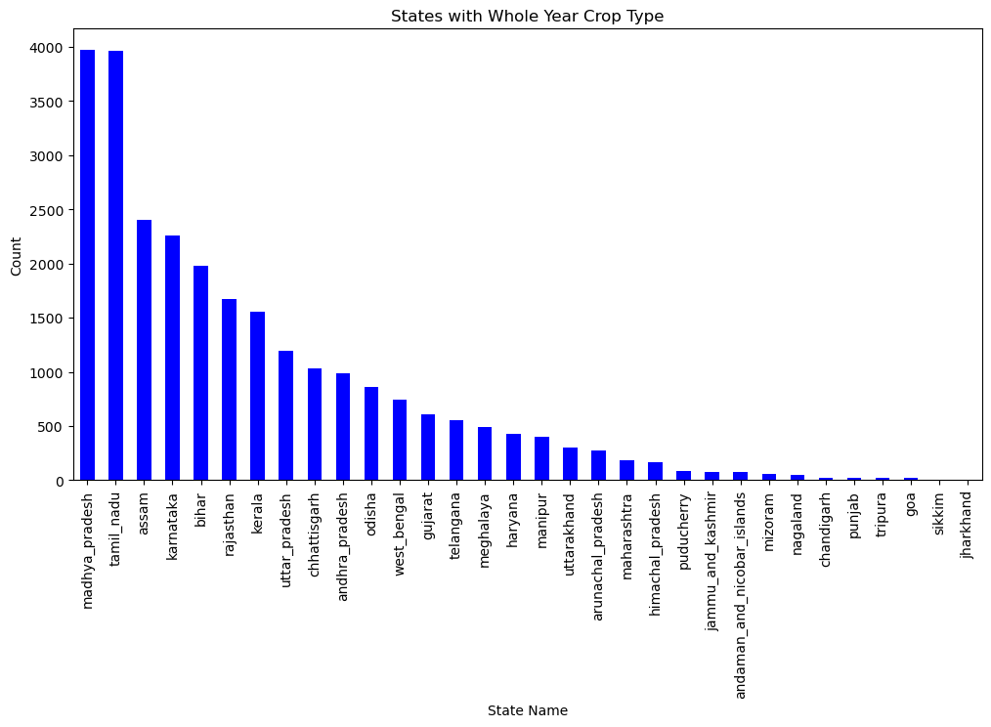
Descriptive Analysis
© All rights reserved by Fireblaze Technologies Pvt. Ltd.

Slide 8
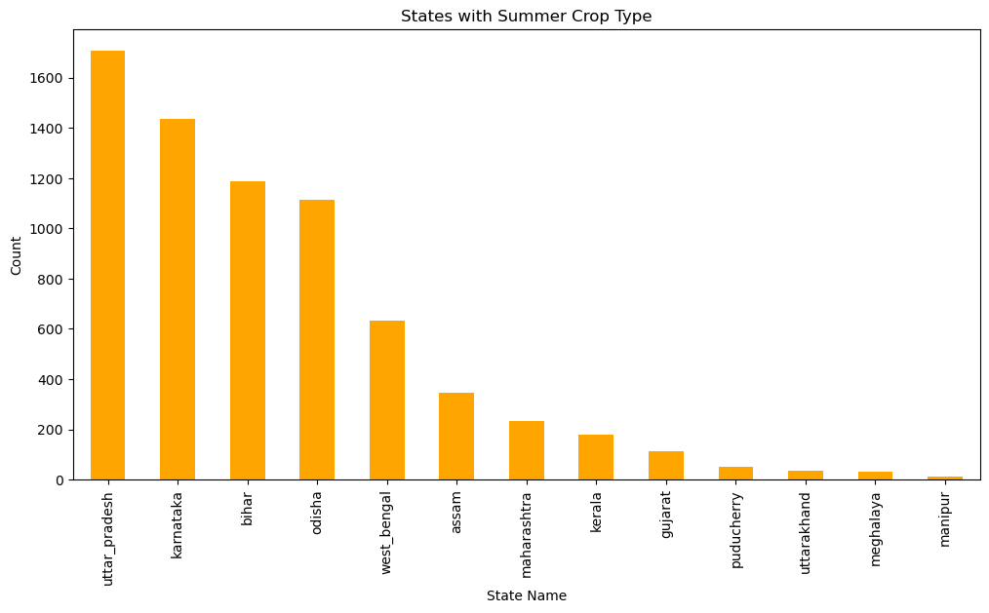
Descriptive Analysis
© All rights reserved by Fireblaze Technologies Pvt. Ltd.

Slide 9
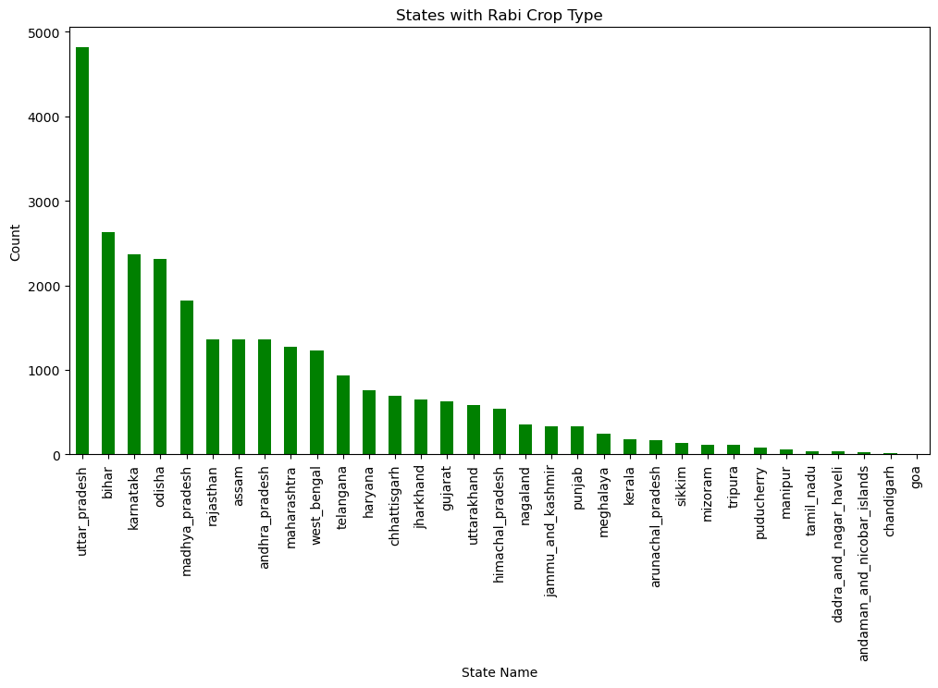
Descriptive Analysis
© All rights reserved by Fireblaze Technologies Pvt. Ltd.

Slide 10
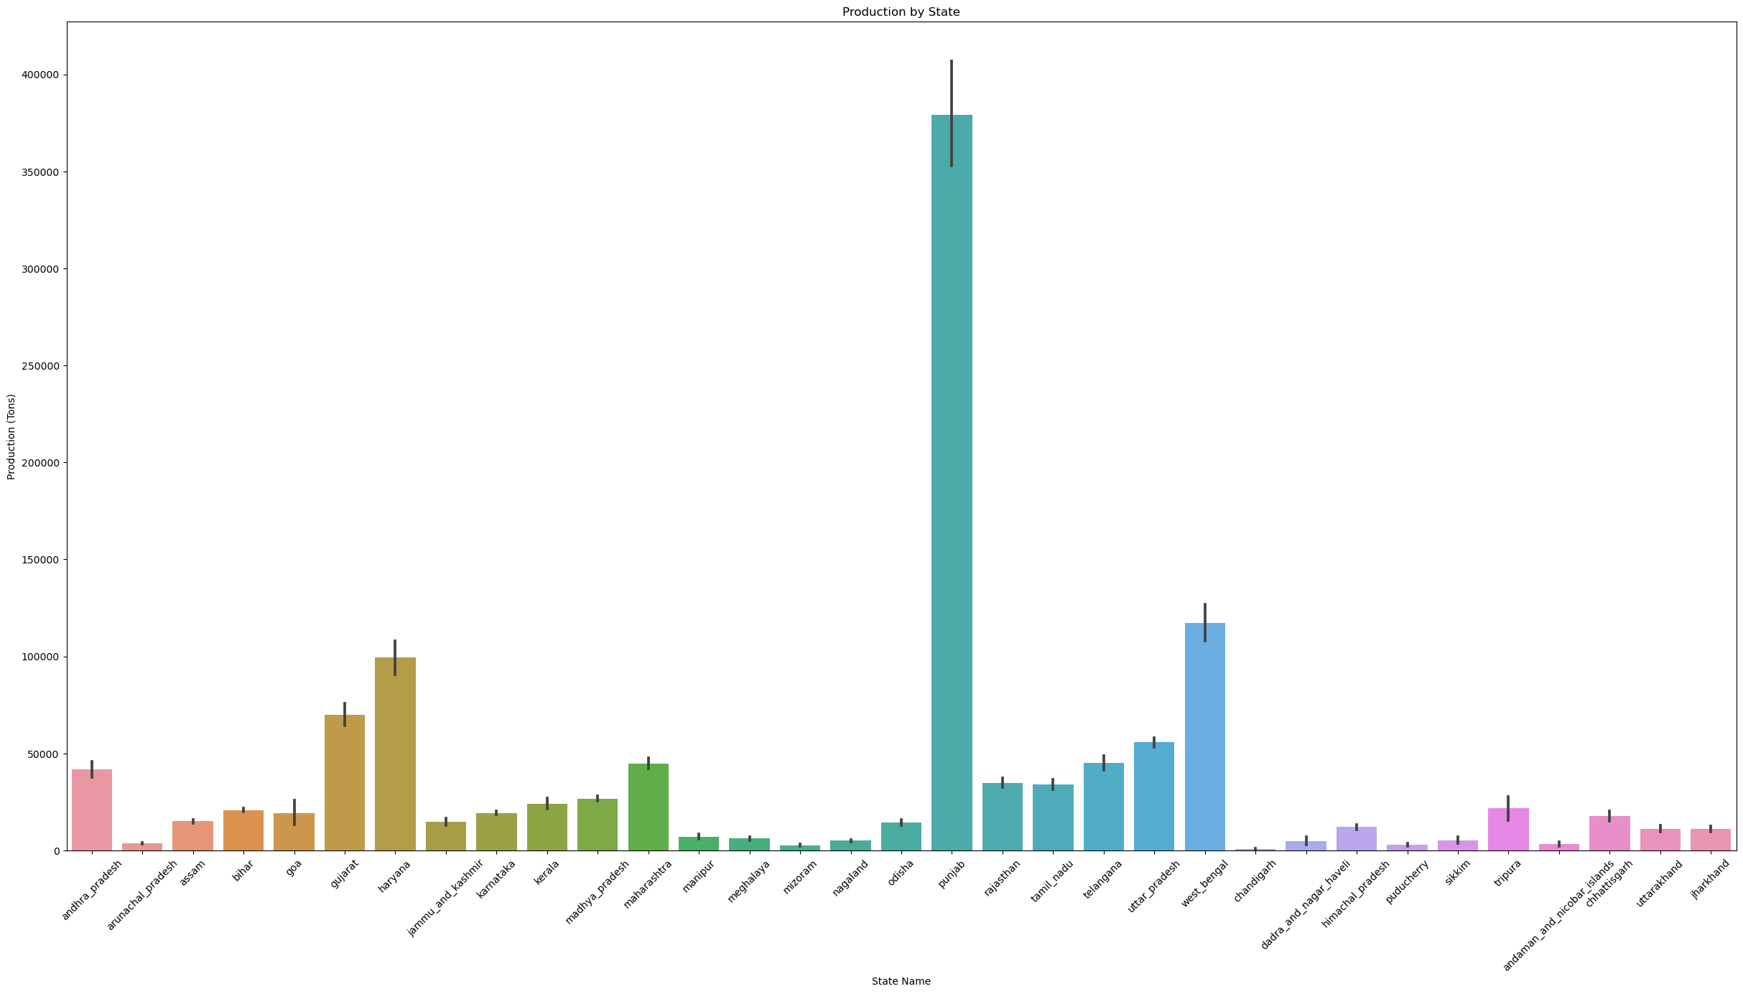
Descriptive Analysis
© All rights reserved by Fireblaze Technologies Pvt. Ltd.

Slide 11
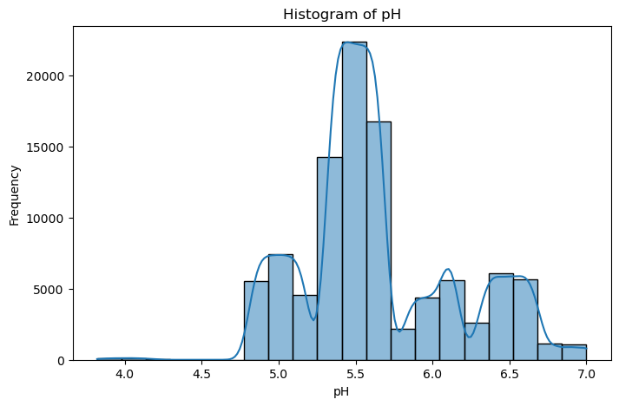
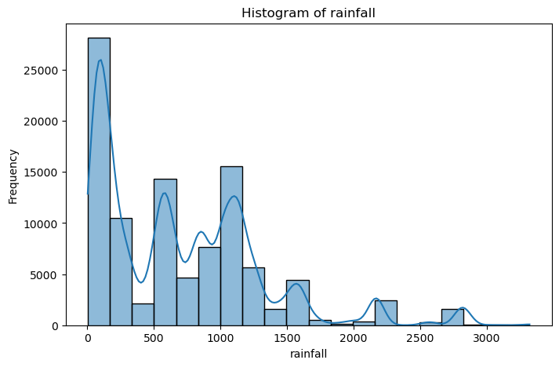
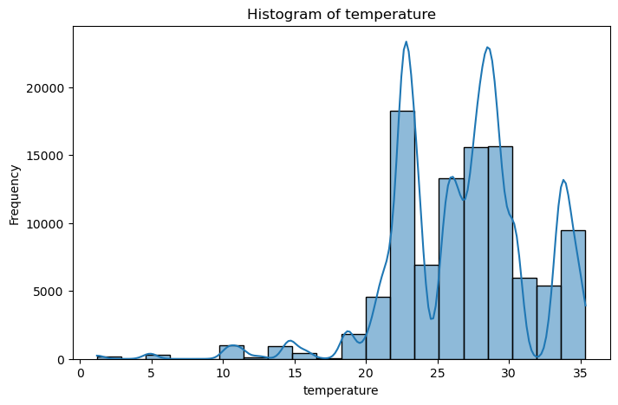
Descriptive Analysis
© All rights reserved by Fireblaze Technologies Pvt. Ltd.

Slide 12
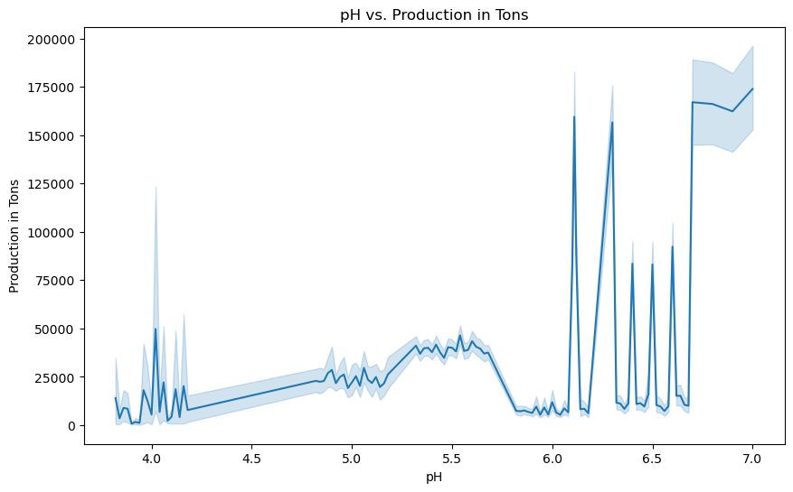
Descriptive Analysis
© All rights reserved by Fireblaze Technologies Pvt. Ltd.

Slide 13

Proposed Solution
Assam's Efficiency: Assam exhibits high yield per area, indicating efficient agricultural practices or favourable conditions.
Arunachal Pradesh's Temperature Impact: Arunachal Pradesh's lowest temperature suggests potential influences on crop types or agricultural calendars.
Bihar's Production Intensity: Bihar's high production despite not having the highest yield implies larger agricultural area or intensive farming practices.
Centralized Database: Create a single system to store all customer information for easy management.
User-Friendly Interface: Design simple screens for bank staff to quickly find and update customer data.
Security Measures: Implement locks and security features to protect customer details from unauthorized access.
Analytics Tools: Integrate tools to analyse customer behaviour, enabling personalized services and improving overall service quality.
© All rights reserved by Fireblaze Technologies Pvt. Ltd.

Slide 14
Proposed Solution
Smart Yield Prediction: Create a tool predicting crop yields using past data, including soil health and weather conditions, aiding farmers in better planning.
Crop Optimization Advisor: Develop a guide suggesting crops tailored to specific regions, considering soil and climate, optimizing yield and profits.
Personalized Nutrient Guide: Design a system recommending optimal fertilization plans based on soil nutrients, promoting resource efficiency and soil well-being.
Seasonal Crop Planner: Integrate a planner aligning crop choices with kharif and rabi seasons, helping farmers adapt to changing weather for improved outcomes.
Centralized Database: Create a single system to store all customer information for easy management.
User-Friendly Interface: Design simple screens for bank staff to quickly find and update customer data.
Security Measures: Implement locks and security features to protect customer details from unauthorized access.
Analytics Tools: Integrate tools to analyse customer behaviour, enabling personalized services and improving overall service quality.
© All rights reserved by Fireblaze Technologies Pvt. Ltd.

Slide 15
Conclusion
  The proposed agricultural system, focusing on predictive analytics and user-friendly tools, aims to boost farmers' efficiency and profits. By integrating cutting-edge technology and continuous learning, it paves the way for a resilient and adaptive future in agriculture, ensuring sustained success for farmers.
© All rights reserved by Fireblaze Technologies Pvt. Ltd.

Slide 16

Future Scope
Improved Predictions: Enhance prediction accuracy using advanced models for better insight into future agricultural trends.
Cutting-edge Technology Adoption: Embrace technologies like AI and IoT to transform data analysis, bringing innovation to decision-making processes.
Adaptive Learning Systems: Implement systems that continuously learn and adapt, ensuring predictive models stay relevant in dynamic agricultural scenarios.
User-Friendly Accessibility: Develop easy-to-use interfaces, making insights and recommendations accessible to farmers, fostering widespread adoption.
© All rights reserved by Fireblaze Technologies Pvt. Ltd.

Slide 17

© All rights reserved by Fireblaze Technologies Pvt. Ltd.

